Slide 1

Project Presentation on
HealthSphere: Central University of Karnataka
Presented By
Manish Kumar
22PGMCA20
Guided By:
Dr. Gururaj Mukarambi
Senior Assistant Professor Department of Computer Science

Slide 2
Content
Introduction
Existing System
Software & Hardware Requirements
Proposed System
Methodology
Implementations
Home Page
Register as Patient
Patient Login
Patient Successfully login
Login as Admin
Welcome Admin Page
Add Doctor
Login as Doctor
Successfully Doctor login
Logout Screen…
Deployment
Conclusion
References
Thanking You

Slide 3
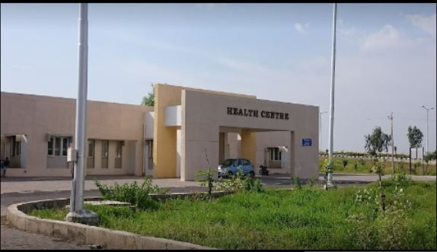
Introduction
The Central University of Karnataka stands as a beacon of academic excellence, attracting thousands of students, faculty, and staff from diverse backgrounds and disciplines. With such a dynamic and vibrant community, the need for efficient, accessible, and high-quality healthcare services has become increasingly imperative. Recognizing this need, HealthSphere: Central University of Karnataka emerges as an innovative solution, designed to revolutionize healthcare management within the university campus.
As a hub for academic pursuits and personal growth, the Central University of Karnataka serves as a second home to its members. However, amidst the rigors of academic life, the importance of prioritizing health and well-being can often be overlooked. HealthSphere aims to change this narrative by providing a centralized platform that integrates modern technology, user-friendly interfaces, and robust functionalities to streamline healthcare processes and promote a culture of wellness within the university community.

Slide 4
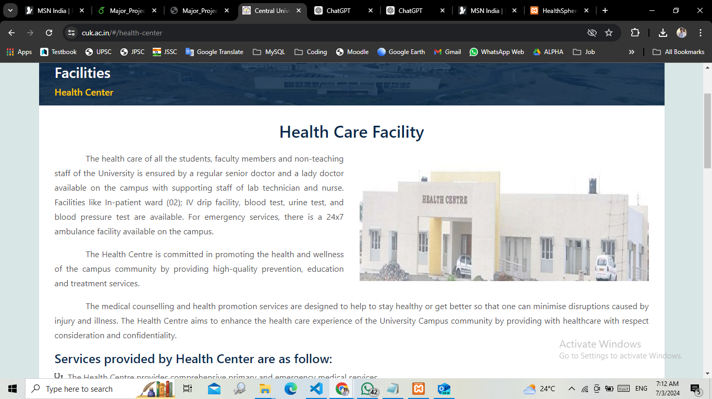
Existing System

Slide 5
Software Requirements
Frontend Development:
HTML : For structuring the web pages.
CSS : For styling and layout of the web pages.
JavaScript : For client-side interactivity and dynamic content.
Bootstraps : To build user friendly and responsiveness.
Backend Development:
PHP : PHP is a server scripting language, and a powerful tool for making dynamic and interactive Web pages..
Database:
MySQL : As a structured database for storing user data, medical records, appointments, and other relevant information.
Authentication and Authorization: JWT (JSON Web Tokens): For secure user authentication and authorization.
• bcrypt.js: For hashing and salting passwords to enhance security.
Deployment:
Hosting Platform: Deployment of the application on a suitable hosting platform such as AWS for scalability, reliability, and performance.

Slide 6
Hardware Requirements
1. Processor (CPU): Multi-core processor with at least 2.0 GHz clock speed.
2. Memory (RAM): Minimum 4GB, recommended 8GB or higher for better performance.
3. Storage (Hard Disk Drive or Solid State Drive): At least 100GB of storage space for hosting application and database files.
4. Network Interface: Ethernet port or Wi-Fi adapter for network connectivity.

Slide 7
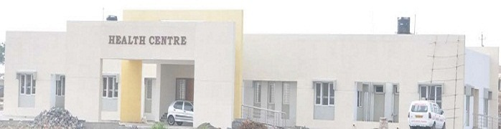
Proposed System
The aim of the proposed system is to develop a system with improved facilities. The proposed system can overcome all the limitations of the existing system such as, Student’s information is maintained in the database, It gives more security to data, Ensures data accuracy, Reduces paperwork and saves time, Eligible students get more priority chance.
The HealthSphere: Central University of Karnataka, is a sophisticated healthcare management platform designed to revolutionize the delivery of healthcare services within the university community. It comprises a comprehensive set of features and functionalities aimed at enhancing accessibility, efficiency, and quality of healthcare services.
Key components of the proposed system include:
User Authentication and Authorization:
Appointment Scheduling:
Electronic Health Records (EHR) Management:
Health Information Resources:
Administrative Tools:

Slide 8

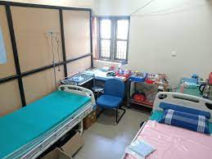
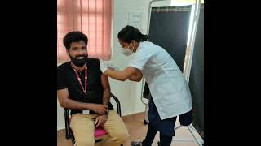
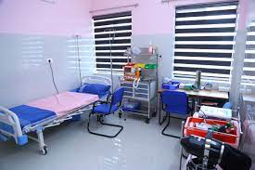
Methodology
Requirement Analysis:
Planning and Design:
Technology Selection:
Development:
Testing:
Deployment:
Training and Documentation:
Rollout and Feedback:
Maintenance and Support:

Slide 9
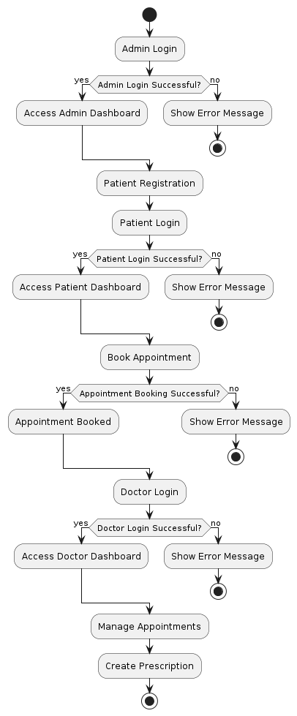
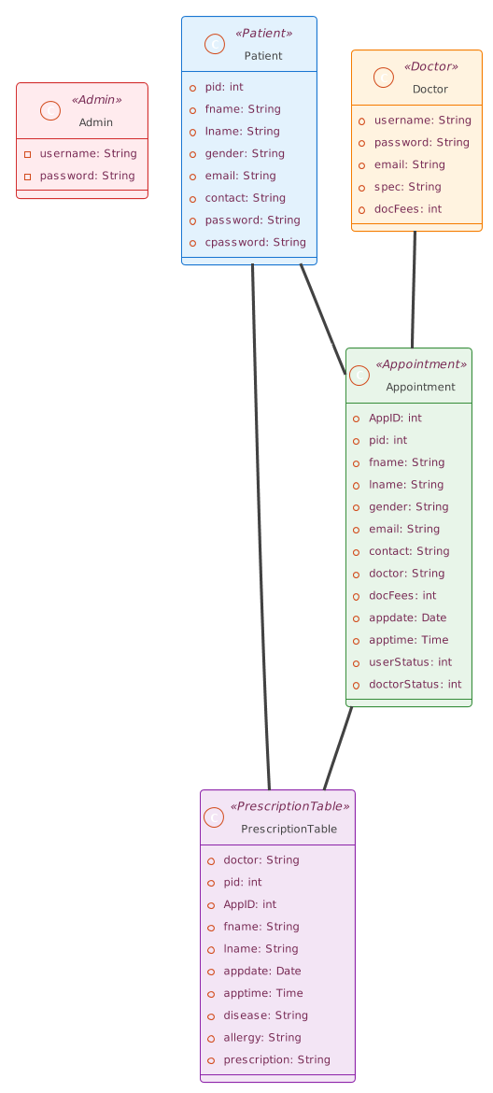
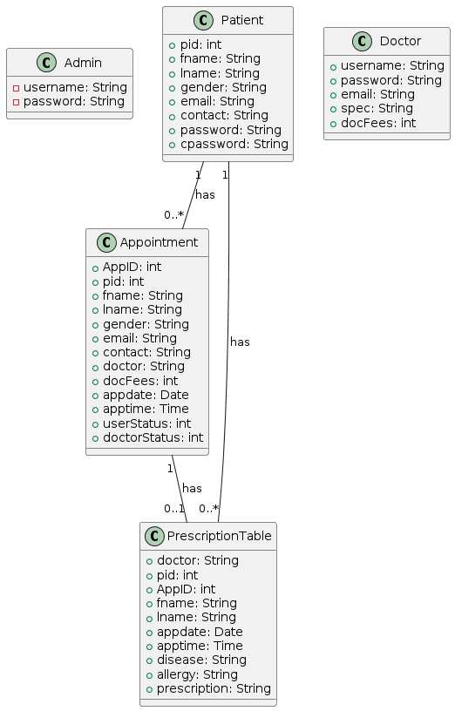
UML USE Case Diagram , Activity Diagram & Class Diagram

Slide 10
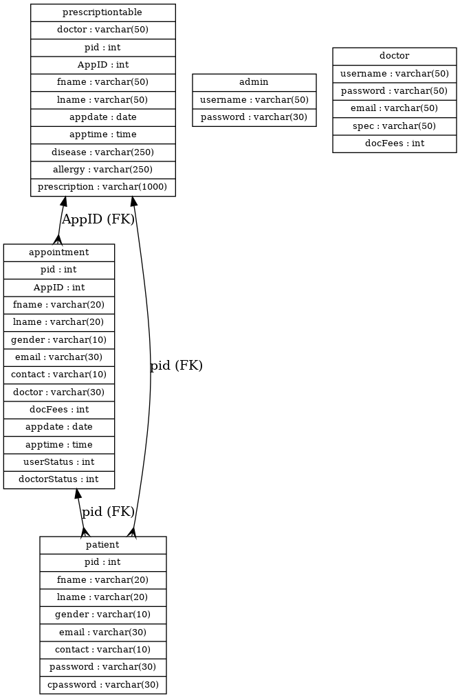
ER Diagram

Slide 11
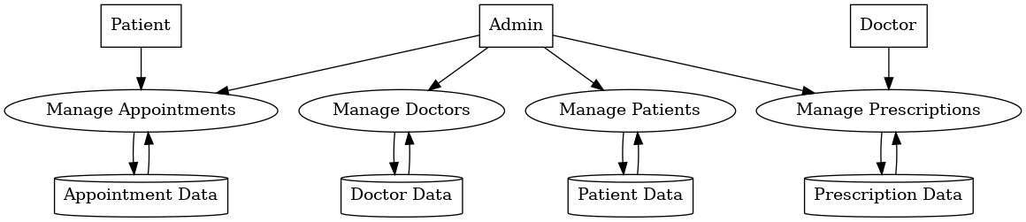
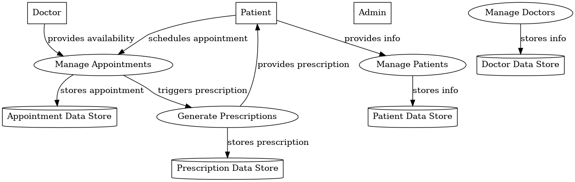
DFD Diagram

Slide 12
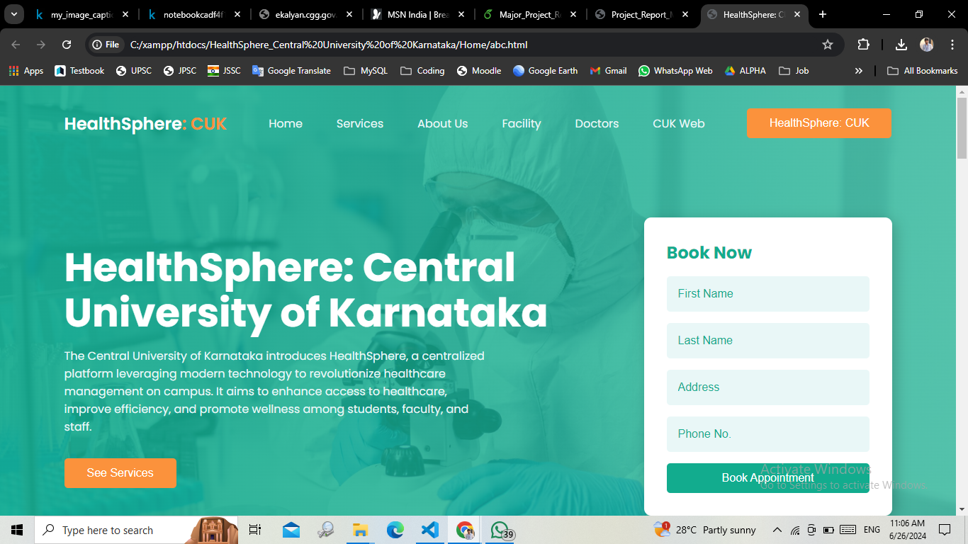
Implementations Home Page

Slide 13
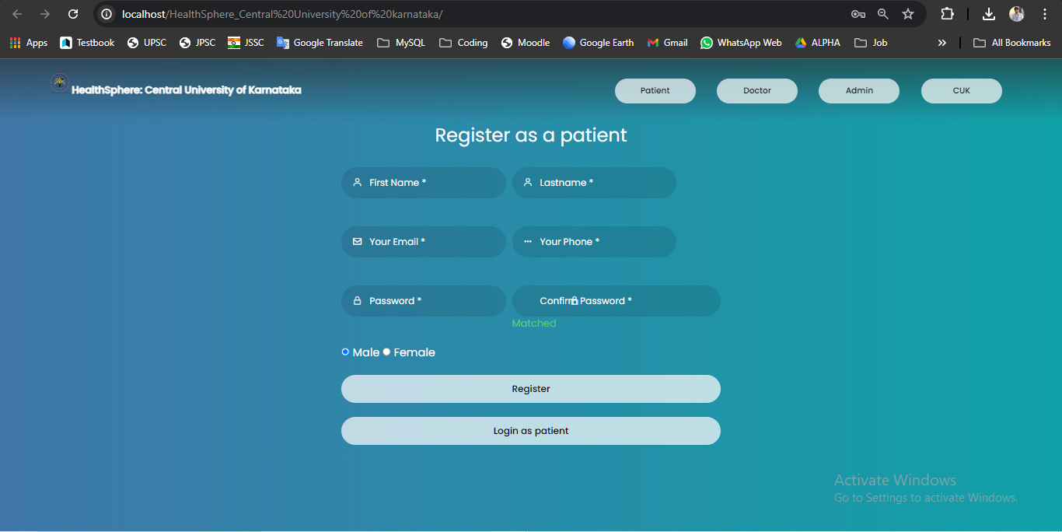
Register as a patient

Slide 14
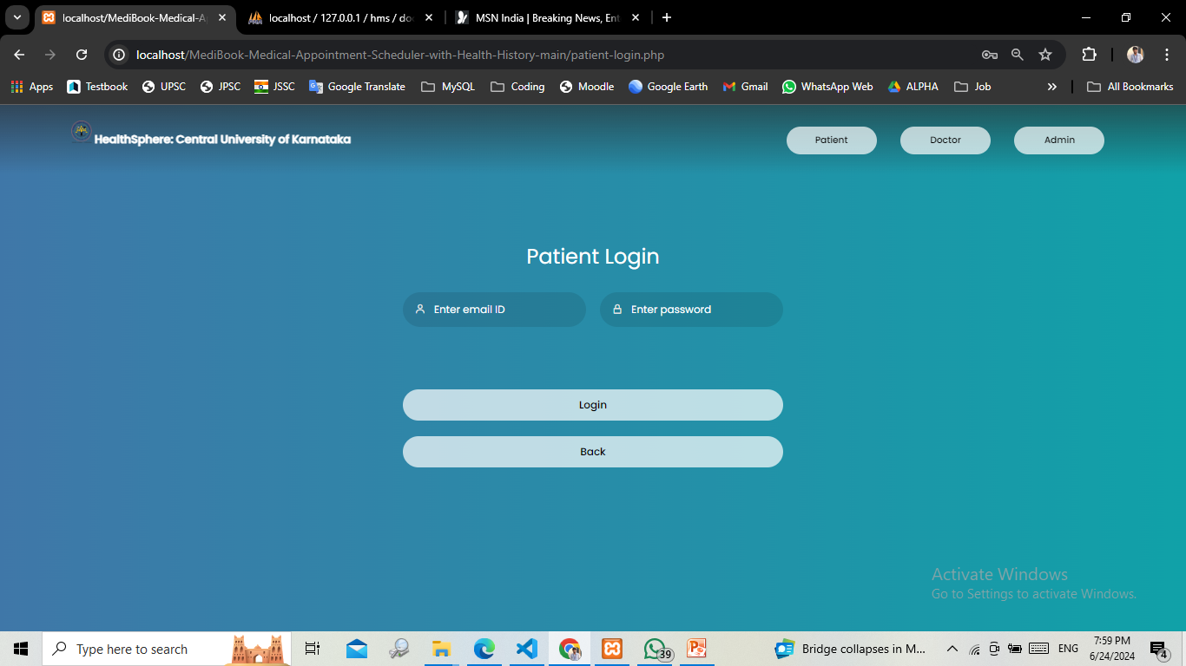
Patient Login

Slide 15
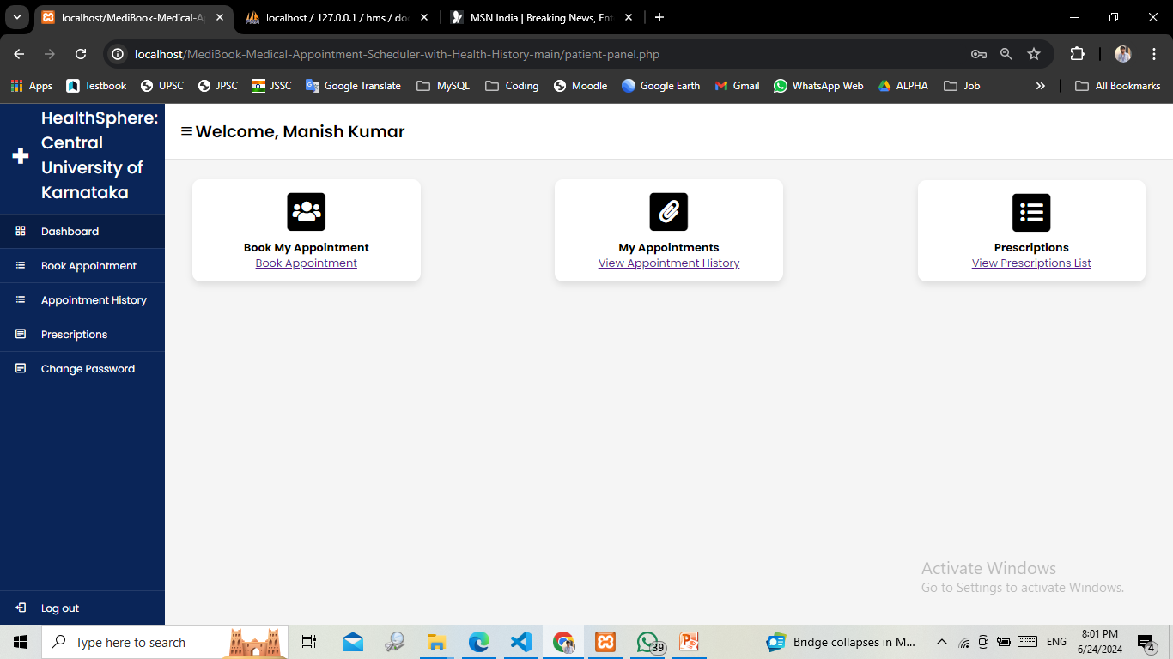
Patient Successfully Login

Slide 16
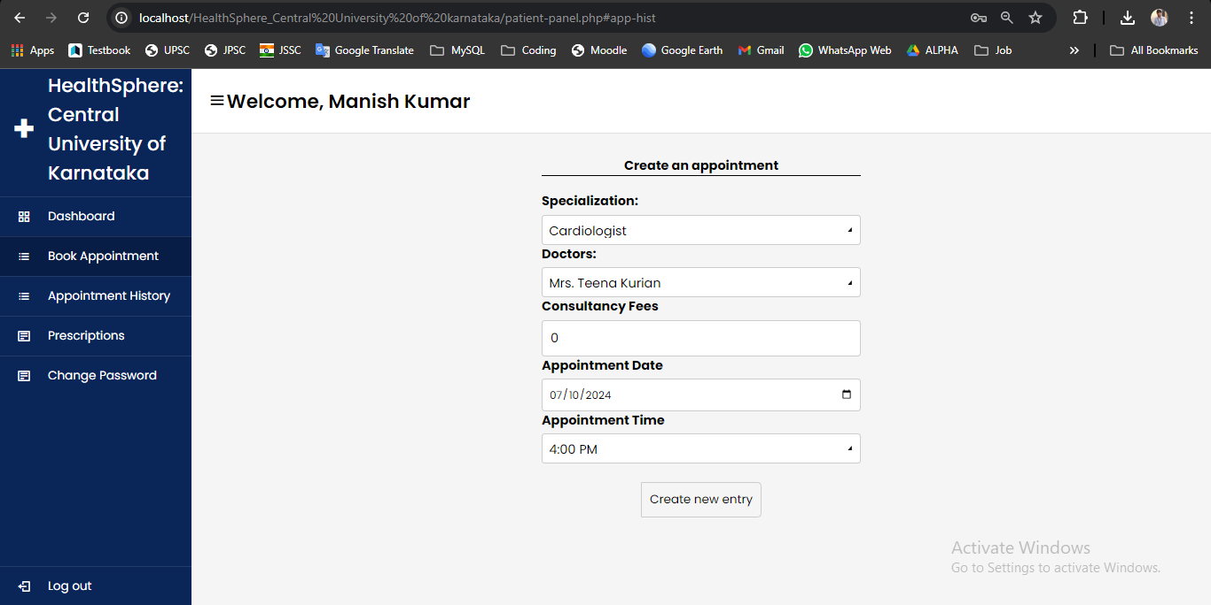
Patient Book Appointment with Doctor

Slide 17
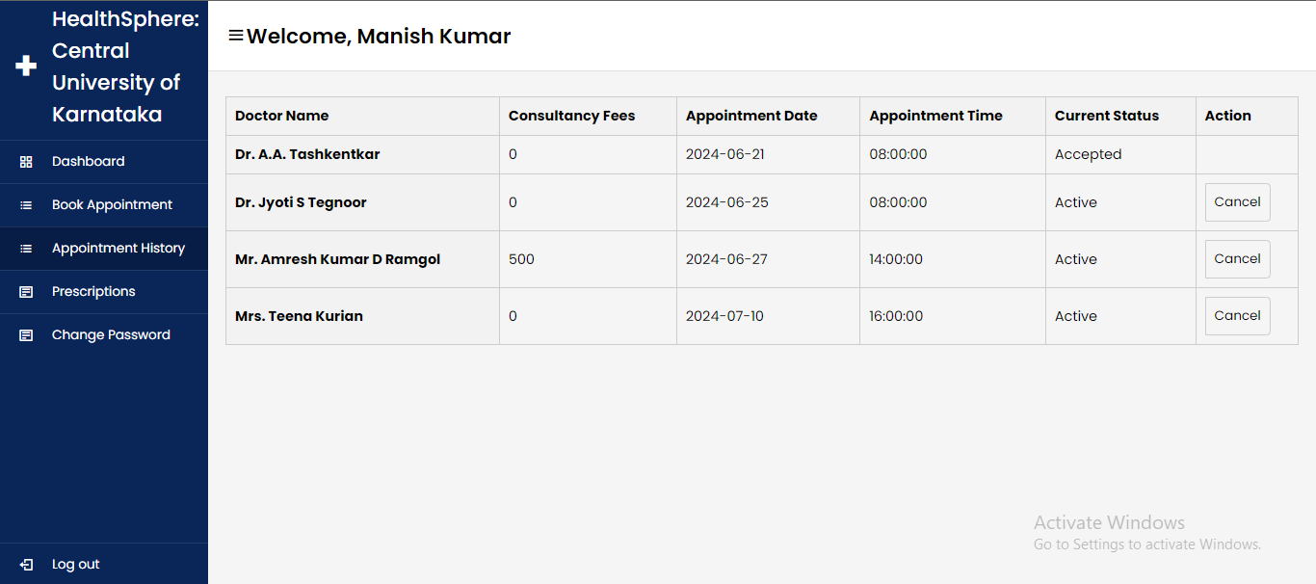
Patient can Manage Appointment with Doctor

Slide 18
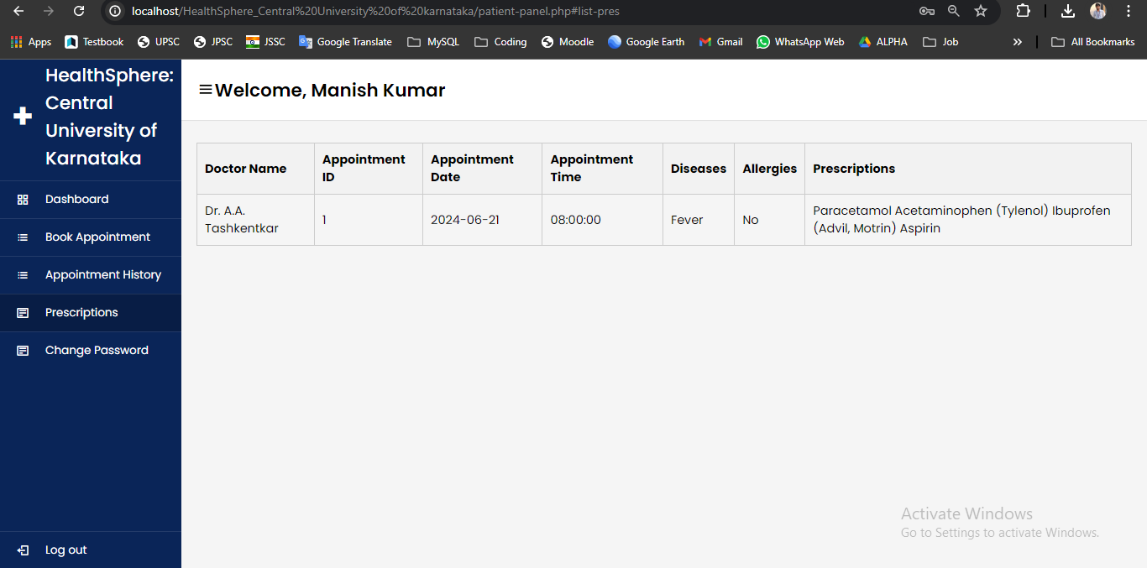
Patient see Prescriptions list Prescribed by Doctor

Slide 19
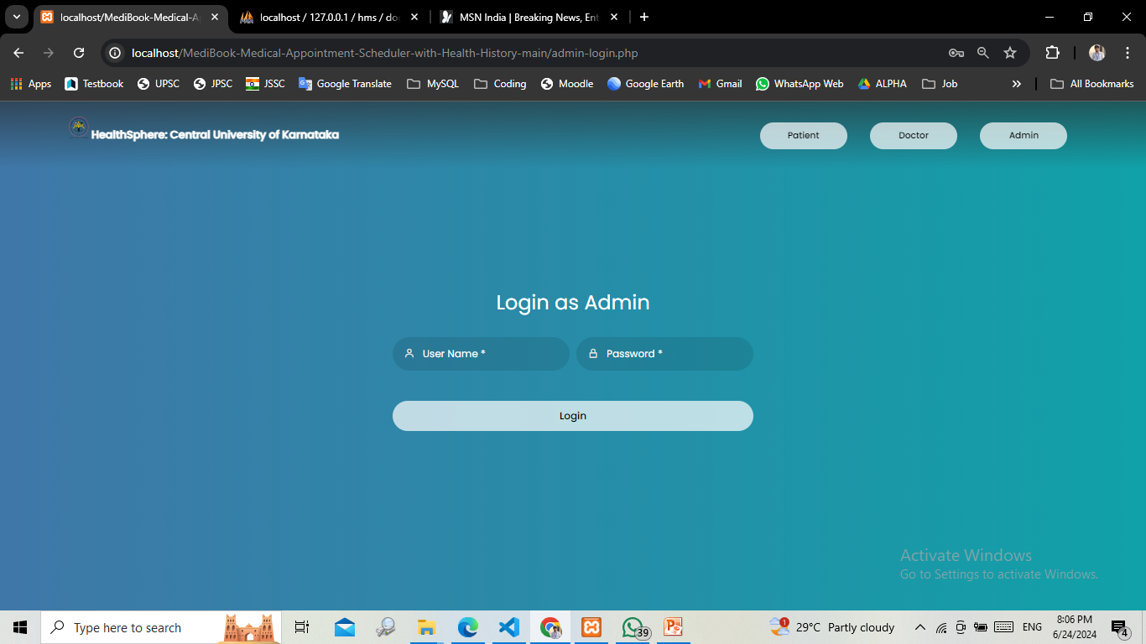
Login as Admin

Slide 20
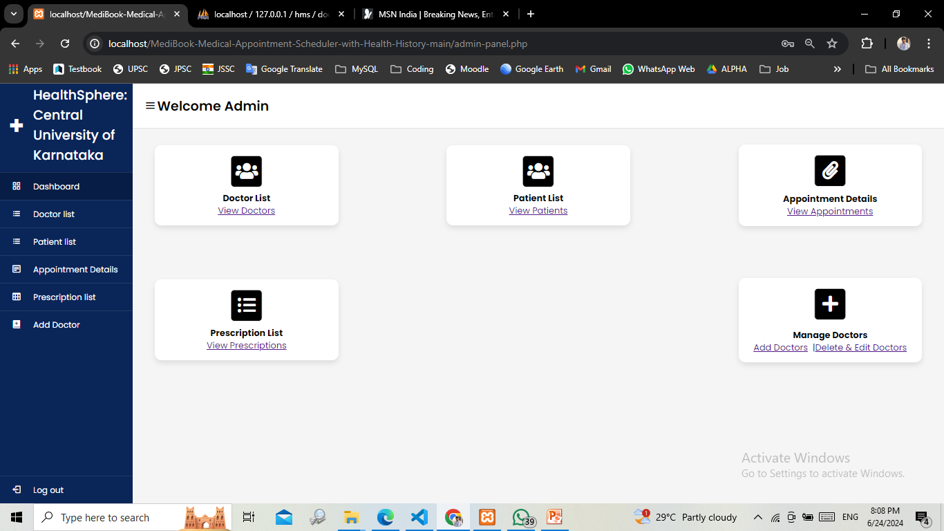
Welcome Admin Login

Slide 21
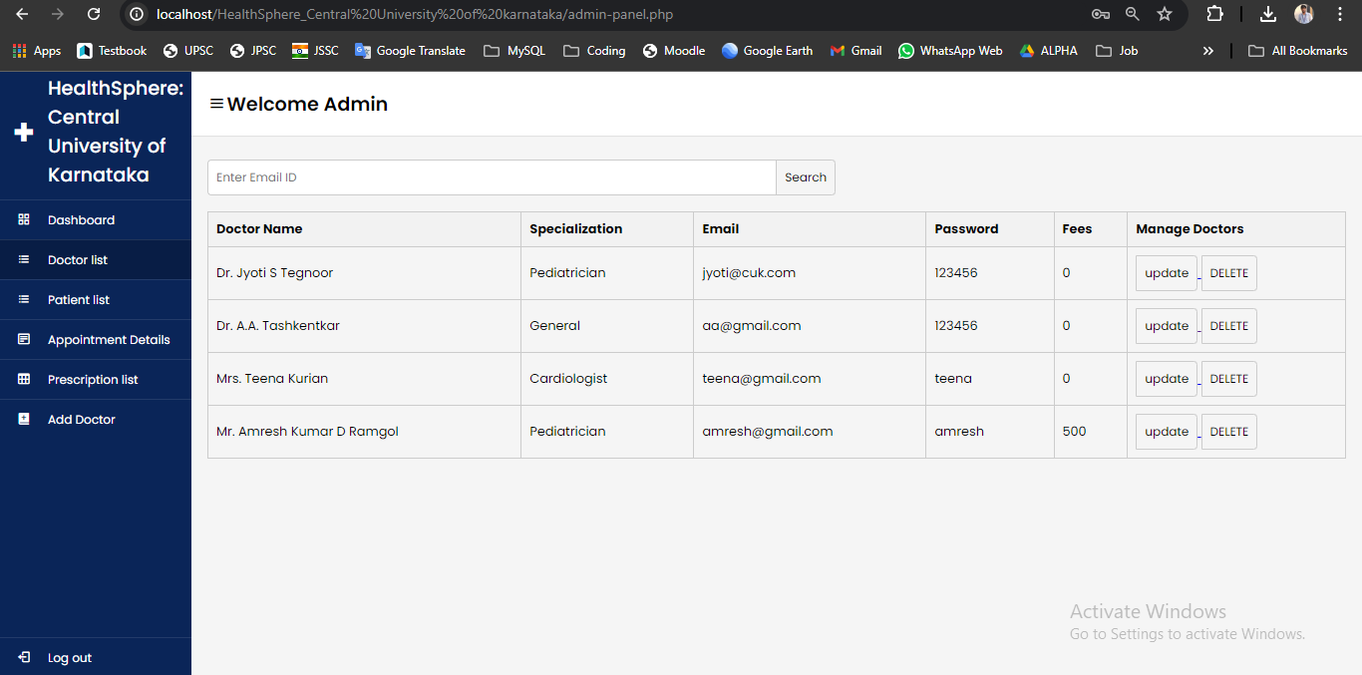
Doctor List

Slide 22
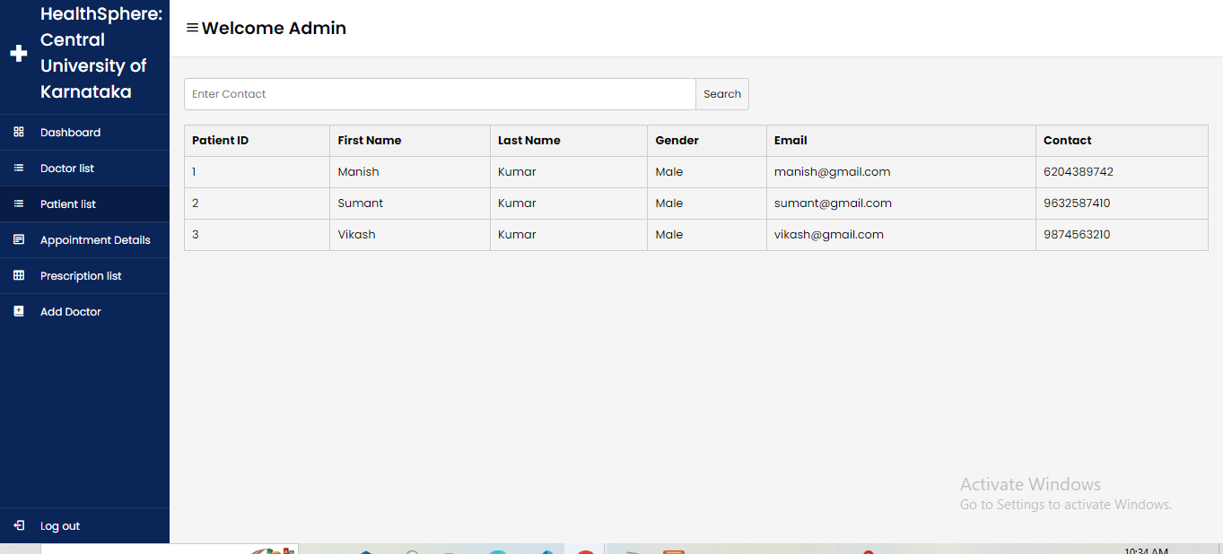
Patient List

Slide 23
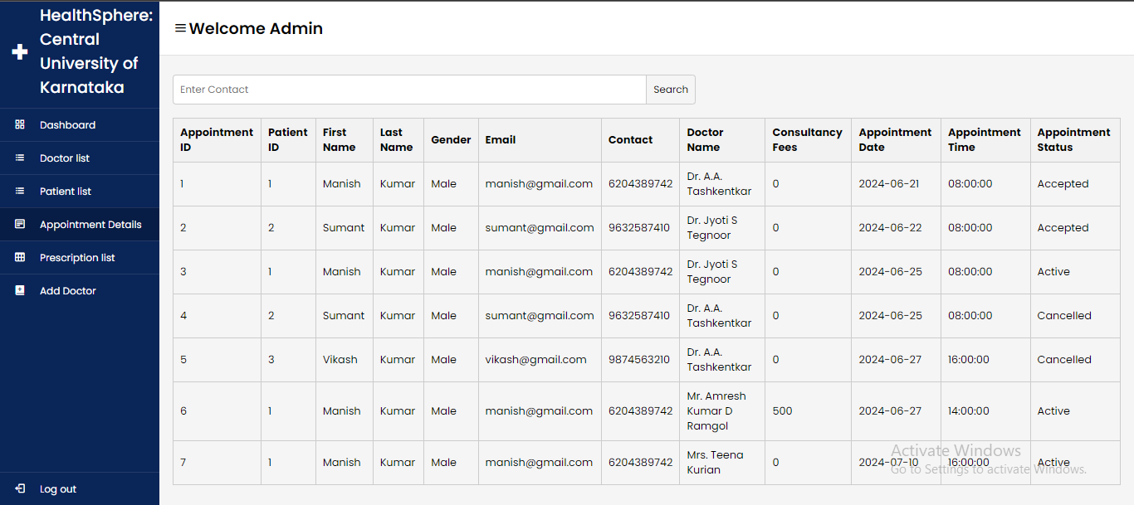
Appointment Details

Slide 24
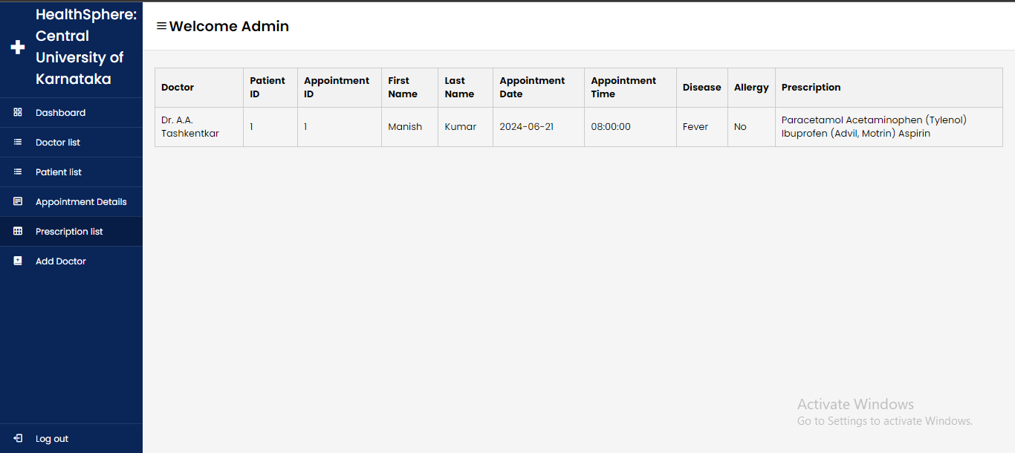
Prescription Details

Slide 25
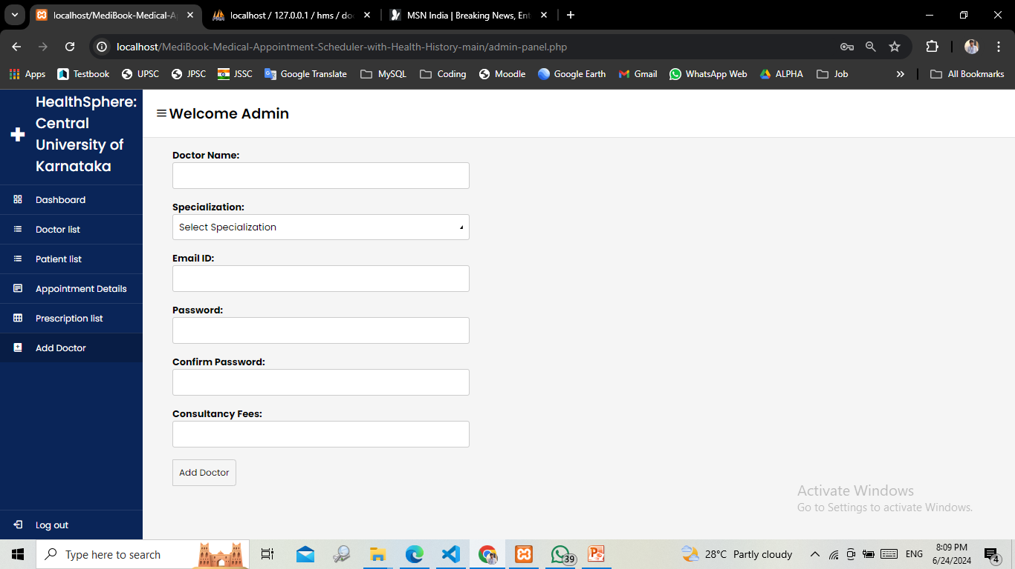
Admin Add Doctor

Slide 26
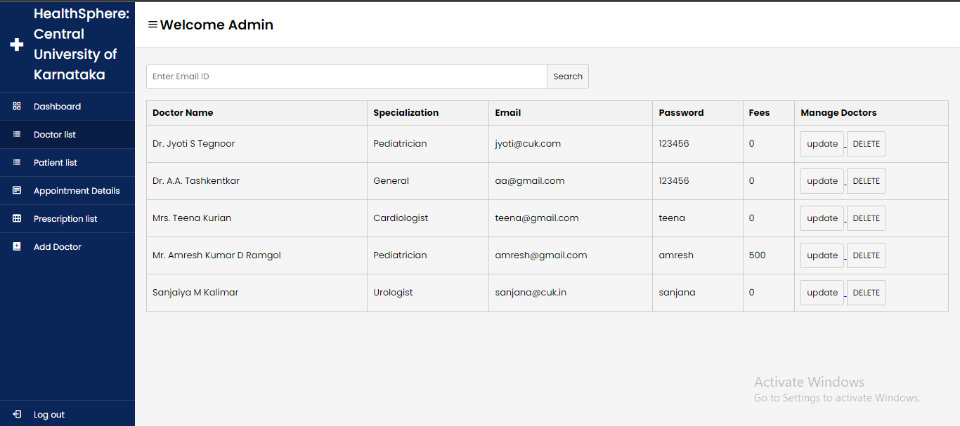
Admin Manage Doctor

Slide 27

Login as Doctor

Slide 28
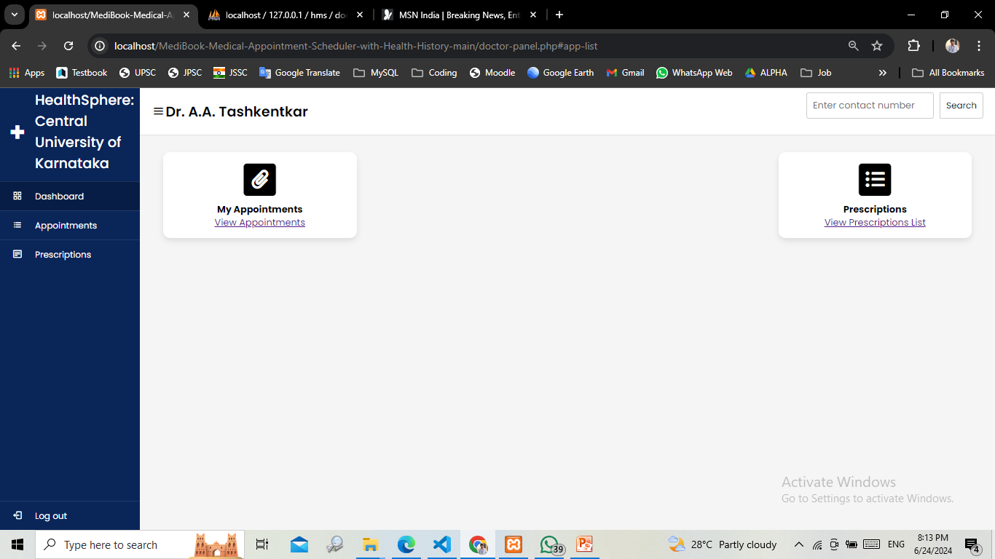
Successfully Doctor login

Slide 29
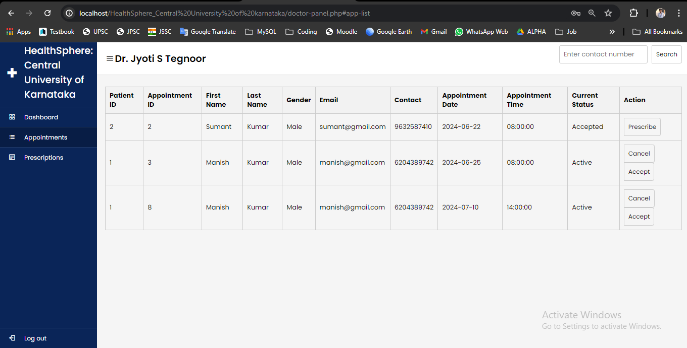
Appointment with Doctor

Slide 30
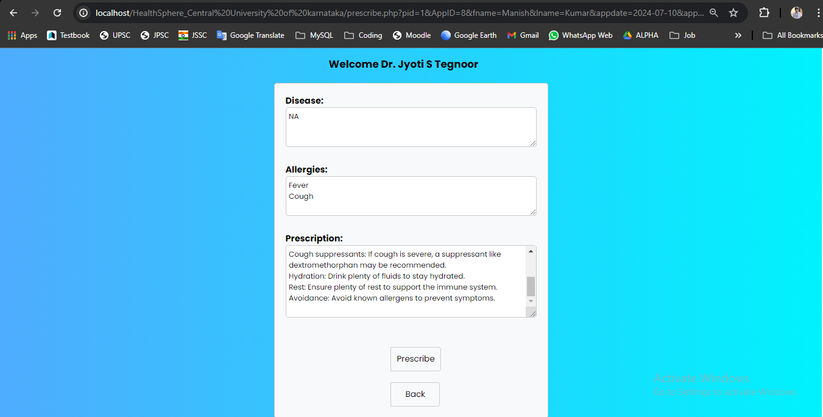
Prescribe Medicine to Patient

Slide 31
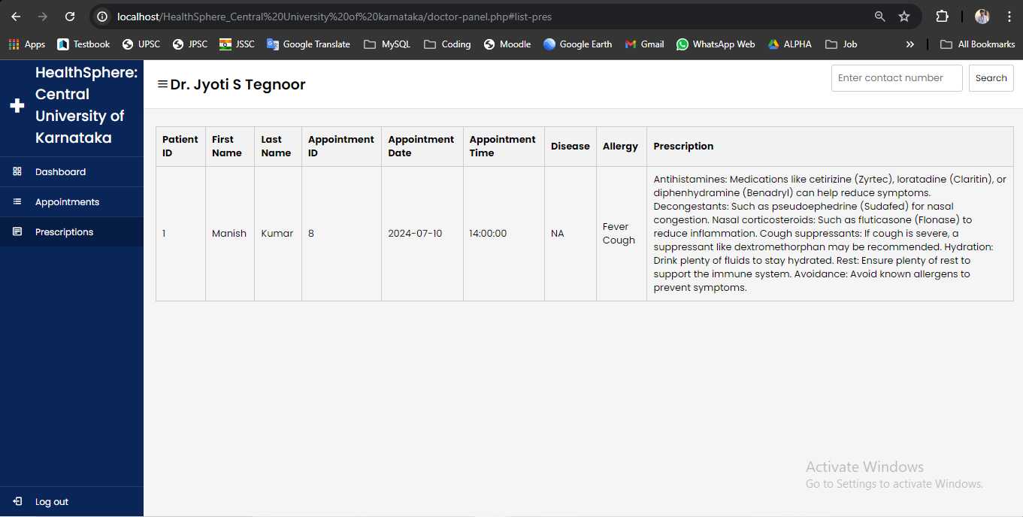
Prescription List

Slide 32
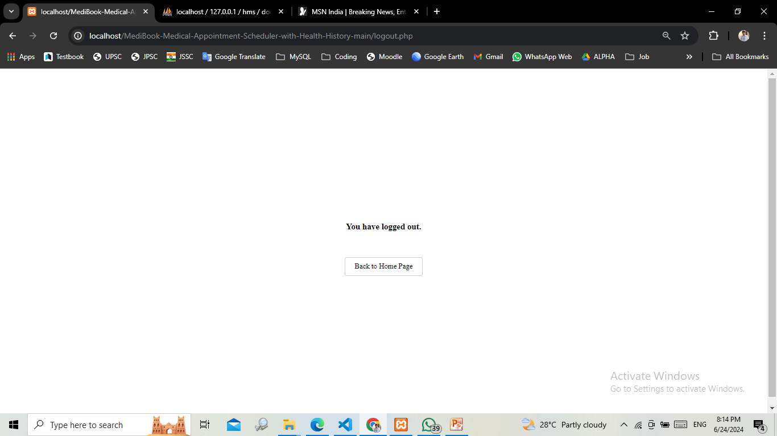
Logout

Slide 33
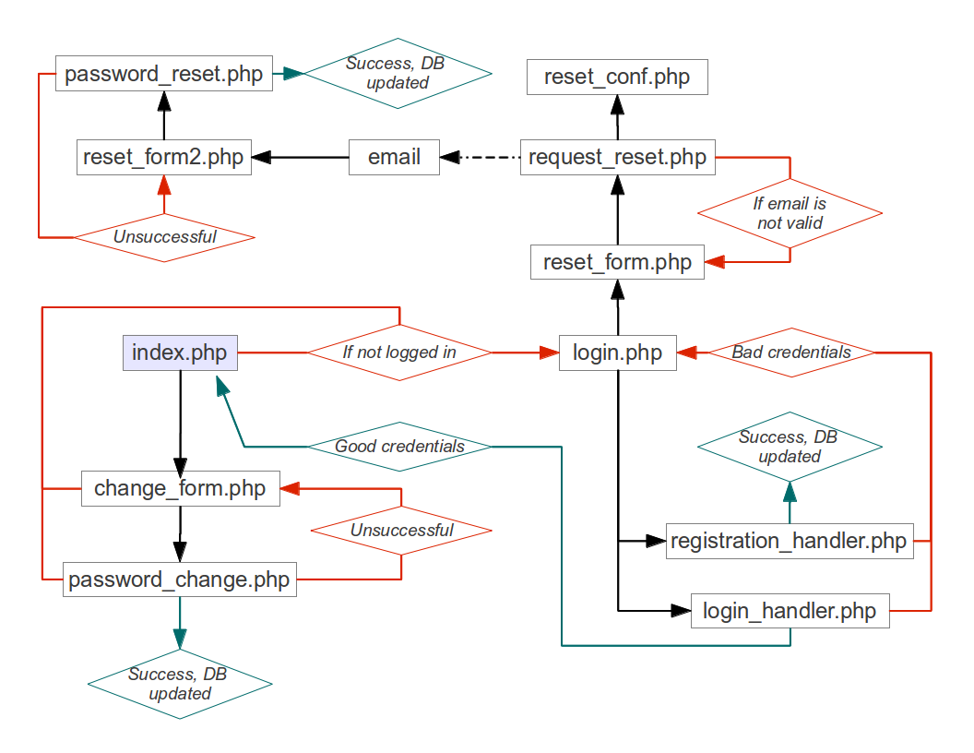
Login Process Diagram

Slide 34
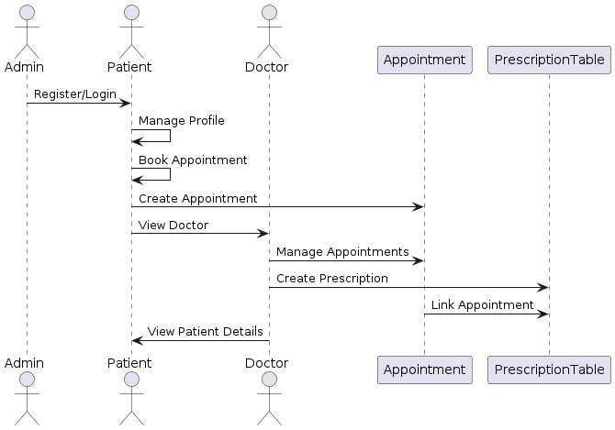
Collaboration Diagram

Slide 35
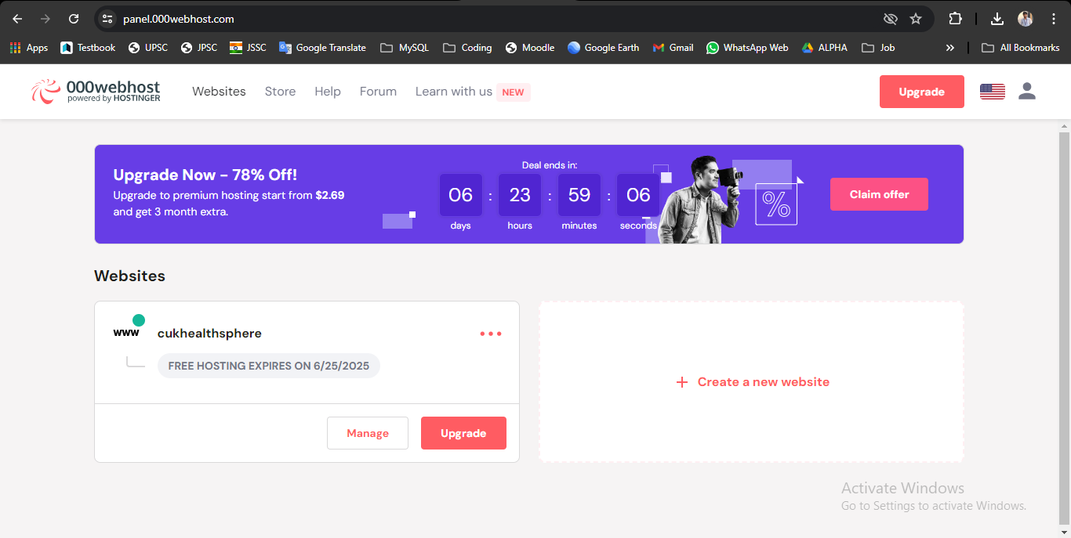
Deployment Diagram

Slide 36
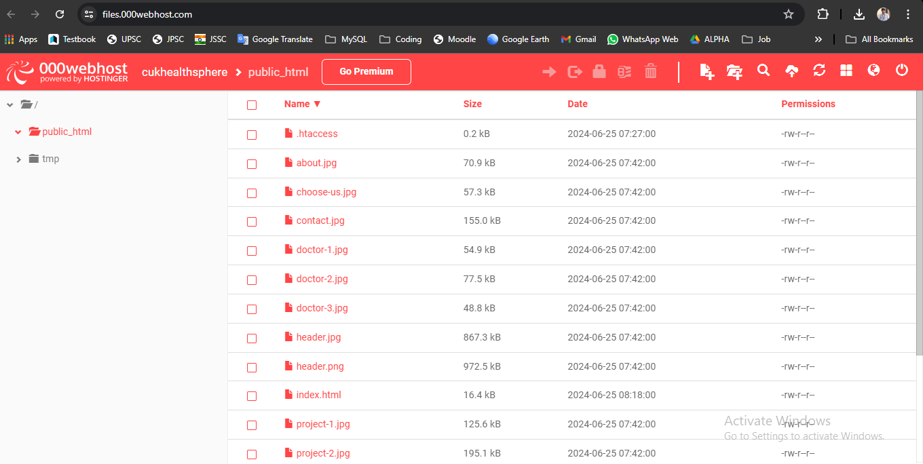
Website File Management

Slide 37
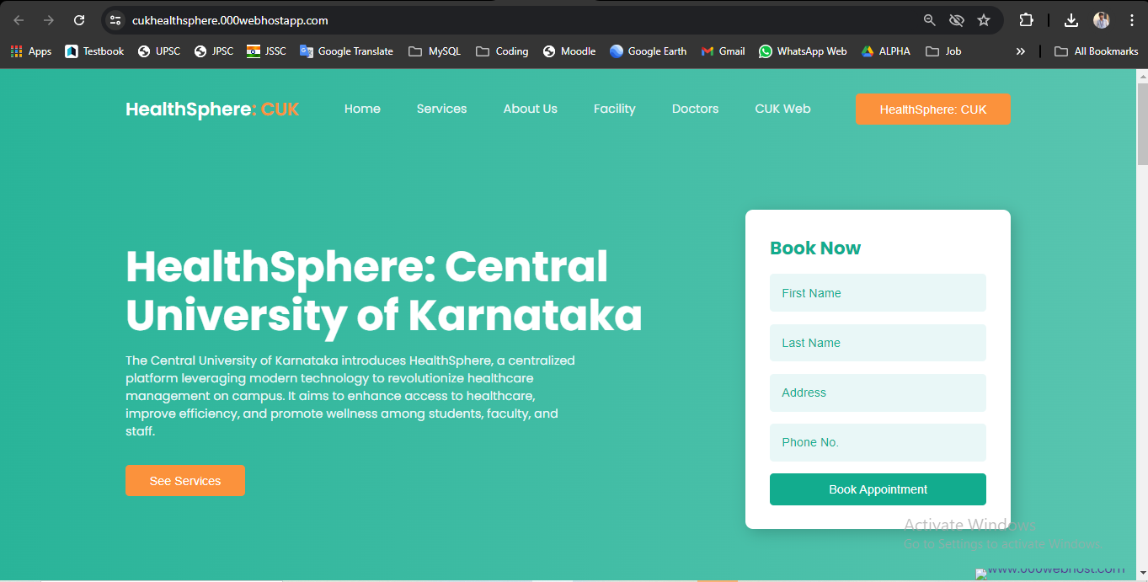
Deployed on Server Live HeathSphere: Central of Karnataka Website

Slide 38
Conclusion
The HealthSphere project has successfully delivered a comprehensive health management system for the Central University of Karnataka. Through meticulous planning and execution, the project integrates frontend and backend technologies, robust database management, and external service integration.
The user-friendly interface facilitates seamless appointment scheduling, medical record management, and access to health-related resources. Deployment on scalable platforms ensures reliability, security, and performance, with continuous testing and quality assurance maintaining high standards.
Moving forward, HealthSphere aims to further promote proactive health management practices and empower individuals to take control of their well being, making a lasting and positive impact on stakeholders within the Central University of Karnataka.

Slide 39
References
Smith, E., Johnson, R., & Brown, K. (2020). ”A Review of Patient Satisfaction in Healthcare Centers: Factors Influencing Quality of Care.” Journal of Healthcare Management, 10(2), 45-58.
Patel, A., Williams, M., & Garcia, S. (2019). ”Implementing Telemedicine in Rural Health Centers: Challenges and Opportunities.” Journal of Telemedicine and Telecare, 15(3), 112-125.
Yang, L., Chen, H., & Li, J. (2018). ”Evaluation of Electronic Health Records Implementation in Community Health Centers: A Systematic Review.” International Journal of Medical Informatics, 25(4), 321-335.
Nguyen, T., Smith, J., & Davis, P. (2017). ”Impact of Electronic Health Records on Patient Engagement in Community Health Centers: A Longitudinal Study.” Journal of Health Communication, 12(1), 78-91.
Kim, S., Lee, H., & Park, W. (2016). ”Improving Chronic Disease Management in Urban Health Centers: Lessons Learned from a Quality Improvement Initiative.” Journal of Urban Health, 8(2), 205-218.

Slide 40
Thank You!

